Slide 1
Digital transmission
Sharada Valiveti
Chandan Trivedi
Parita Oza
Umesh Bodkhe

Slide 2
Contents
Digital to Digital Conversion
Analog to Digital Conversion
Transmission Modes

Slide 3
Digital Transmission
Information needs to be converted into either a digital signal or an analog signal
Here, we study schemes and techniques for digital transmission
Digital to Digital Conversion: Converting Digital Data into Digital Signals
Analog to Digital Conversion: Changing Analog signal into digital signal
Transmission Modes: Deciding Serial or Parallel Transmission of data

Slide 4
Digital-to-Digital Conversion
Line Coding Line Coding Schemes Block Coding Scrambling

Slide 5
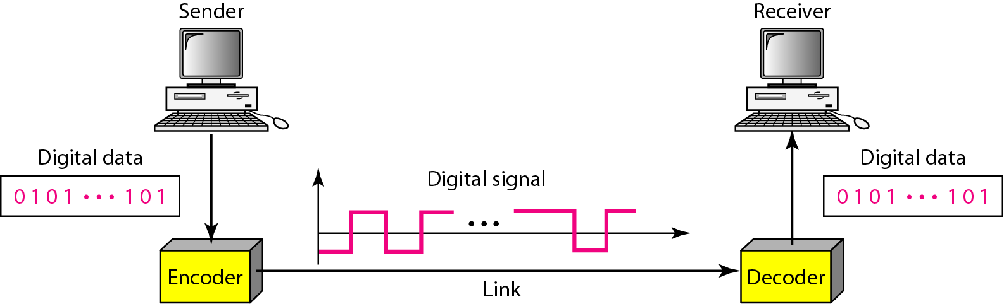
Line Coding
Process of converting digital data (in bits) to digital signals is called the Line Coding
Line Coding and Decoding

Slide 6
Line Coding: Common Characteristics
Signal Element Versus Data Element
Data element is the smallest entity that can represent a piece of information (this is the bit)
Signal element carries data elements and is the shortest unit of a digital signal
Wish to send data element
Can send signal element
Data elements are being carried
Signal elements are the carriers
Define ratio r as the number of data elements carried by one signal element

Slide 7
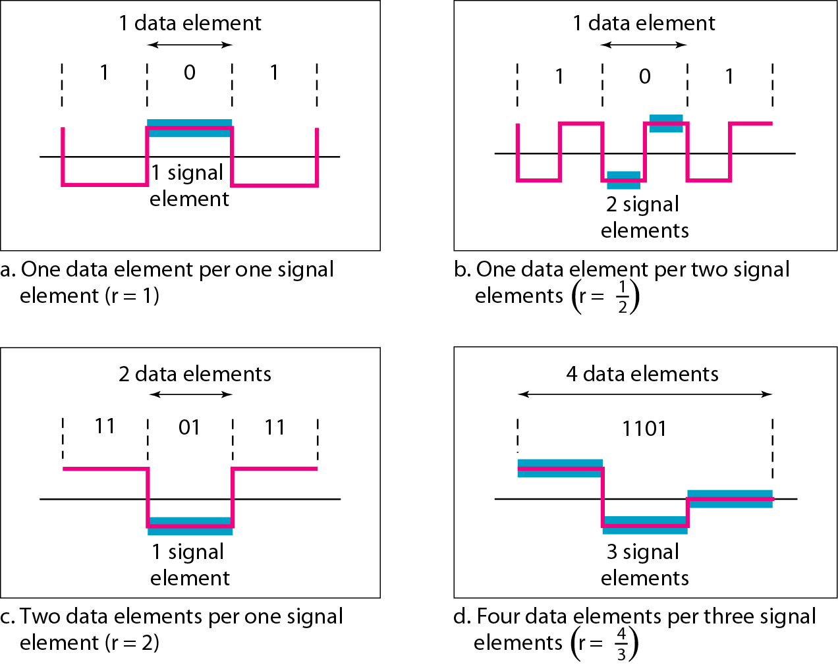
Signal Element Vs. Data Element

Slide 8
Line Coding: Common Characteristics
Data Rate Versus Signal Rate
Data rate defines number of data elements (bits) sent in 1 second (bps)
Signal rate is the number of signal elements sent in 1 second (baud)
Data rate is also called bit rate
Signal rate is called a pulse rate or modulation rate or the baud rate
Goal of the data communications is to increase data rate while decreasing signal rate
Increasing data rate increases speed of transmission
Decreasing signal rate decreases the bandwidth requirement

Slide 9
Given S is the Signal Rate, N is the Data Rate (bps)
S = N / r
3 cases are possible:
c is case factor, which varies for the best, average and worst cases
Best case - we need minimum signal rate
Average case – we are interested in
Worst case – we need maximum signal rate
S_{ave} = c X N X (1/r) baud

Slide 10
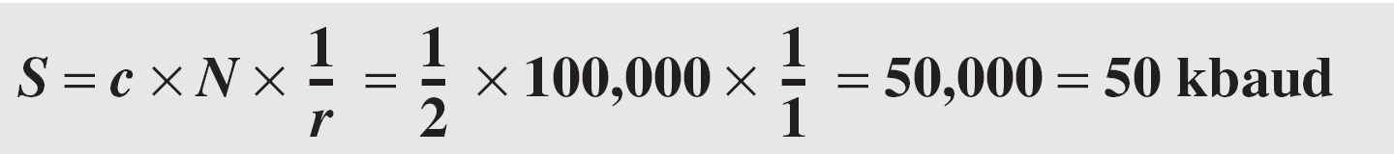
A signal is carrying data in which one data element is encoded as one signal element ( r = 1). If the bit rate is 100 kbps, what is the average value of the baud rate if c is between 0 and 1?
Solution
We assume that the average value of c is 1/2 . The baud rate is then

Slide 11
Line Coding: Common Characteristics
Bandwidth
Digital signal is nonperiodic
Bandwidth of nonperiodic digital signal is continuous and theoretically infinite
Effective bandwidth is finite
Baud rate and not the bit rate determines the required bandwidth for a digital signal
More changes in signal means injecting more frequencies into signal
Range of bandwidth and Amplitude are also important, rather than its value
Although the actual bandwidth of a digital signal is infinite, the effective bandwidth is finite.

Slide 12
Minimum Bandwidth can be given as –
B_{min} = c X N X (1/r)
Maximum data rate is
N_{max} = (1/c) X B X r

Slide 13
The maximum data rate of a channel (see Chapter 3) is Nmax = 2 × B × log₂ L (defined by the Nyquist formula). Does this agree with the previous formula for N_{max}?
Solution
A signal with L levels actually can carry log₂L bits per level. If each level corresponds to one signal element and we assume the average case (c = 1/2), then we have

Slide 14
Line Coding: Common Characteristics
Baseline Wandering
Receiver calculates a running average of the received signal power
This average is called Baseline
Incoming signal is evaluated against this baseline to determine the value of the data element
A long string of 0s or 1s can cause a drift in the baseline (baseline wandering)
Receiver cannot decode the information correctly
Hence prevent baseline wandering

Slide 15
Line Coding: Common Characteristics
DC Components
When the voltage level in a digital signal is constant for a while, the spectrum creates very low frequencies
These frequencies (around zero) are called DC (direct-current) components
Present problems for a system that cannot pass low frequencies or that uses electrical coupling
DC component is 0/1 parity that can cause base-band wandering

Slide 16
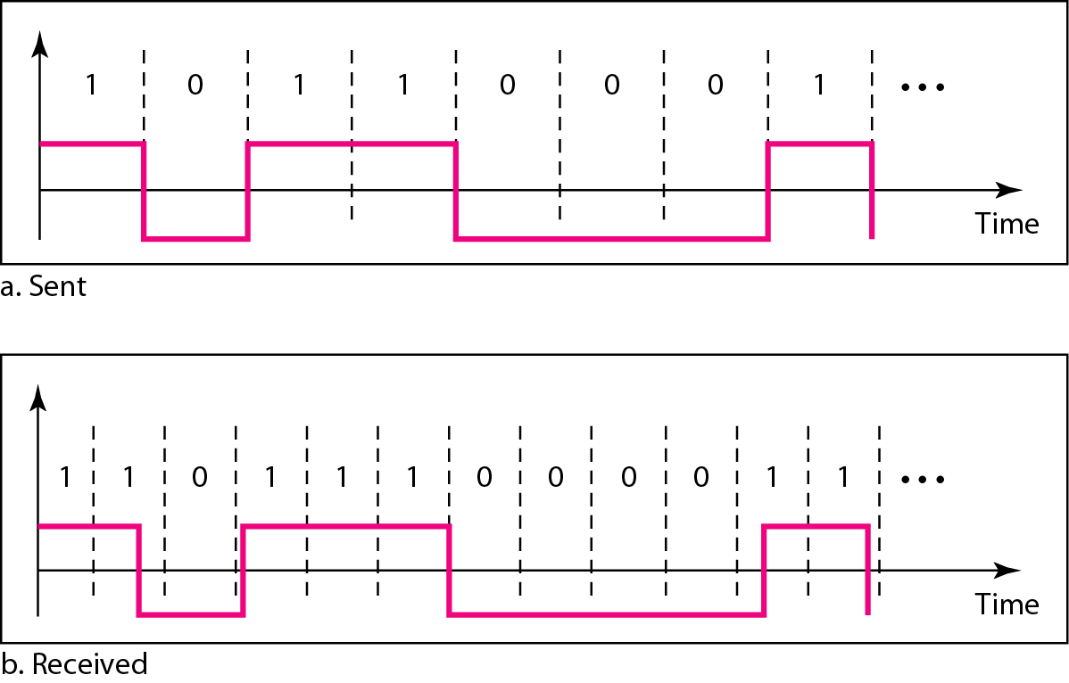
Line Coding: Common Characteristics
Self – synchronization
Receiver’s bit intervals must correspond exactly to the sender’s bit intervals to interpret the signals correctly
Effect of Lack of Synchronization

Slide 17
In a digital transmission, the receiver clock is 0.1 percent faster than the sender clock. How many extra bits per second does the receiver receive if the data rate is 1 kbps? How many if the data rate is 1 Mbps?
Solution
At 1 kbps, the receiver receives 1001 bps instead of 1000 bps.
At 1 Mbps, the receiver receives 1,001,000 bps instead of 1,000,000 bps.

Slide 18
Line Coding: Common Characteristics
Built-in Error Detection
Used to detect some or or all of the errors that occurred during transmission
Immunity to Noise and Interference
Code should be immune to noise and other interferences
Complexity
Costly to implement than a simple one
A signal that uses four signal levels is more difficult to interpret than one that uses only two levels

Slide 19
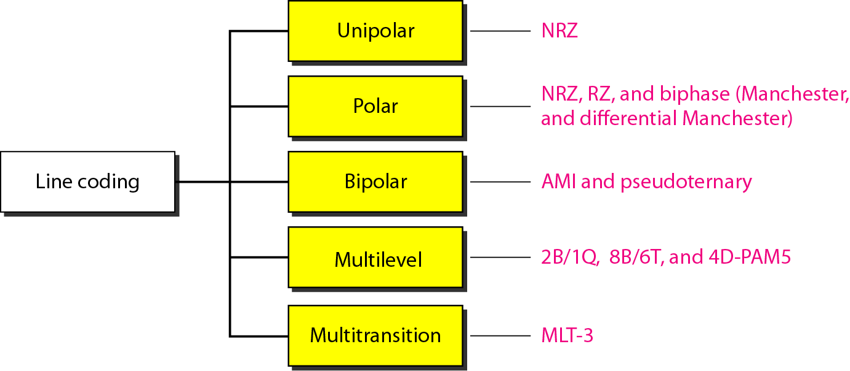
Line Coding Schemes
5 Categories

Slide 20
Line Coding Schemes: Unipolar
All signal levels are on one side of the time axis, either above or below
Designed as a Non-Return-to-Zero (NRZ) scheme
Positive voltage defines bit 1 and the zero voltage defines bit 0
NRZ – signal does not return to zero at the middle of the bit
Scheme is costly
The normalized power (power needed to send 1 bit per unit line resistance) is double
Hence not used in communications these days

Slide 21
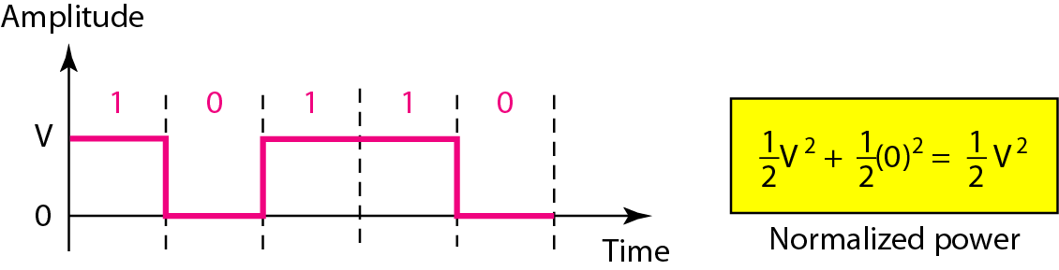
Unipolar NRZ Scheme
Scheme is prone to baseline wandering and DC components.
It has no synchronization or any error detection.
It is simple but costly in power consumption.

Slide 22
Line Coding: Polar
Voltages are on both sides of the time axis
Voltage level for 0 can be positive and the voltage level for 1 can be negative
Non-Return-to-Zero
2 Versions
Non-Return-to-Zero Level (NRZ-L) – Positive Voltage for one symbol and negative for the other
Non-Return-to-Zero Invert (NRZ-I) – the change or lack of change in polarity determines value of symbol
Baseline wandering is common problem
Twice as severe in NRZ-L
Sender/receiver clock synchronization issues
More serious in NRZ-L
Vulnerable to sudden change of polarity in the system
NRZ-L and NRZ-I both have an average signal rate of N/2 Bd.

Slide 23
A system is using NRZ-I to transfer 1-Mbps data. What are the average signal rate and minimum bandwidth?
Solution
The average signal rate is S= c x N x R = 1/2 x N x 1 = 500 kbaud.
The minimum bandwidth for this average baud rate is B_{min} = S = 500 kHz.
Note c = 1/2 for the avg. case as worst case is 1 and best case is 0

Slide 24
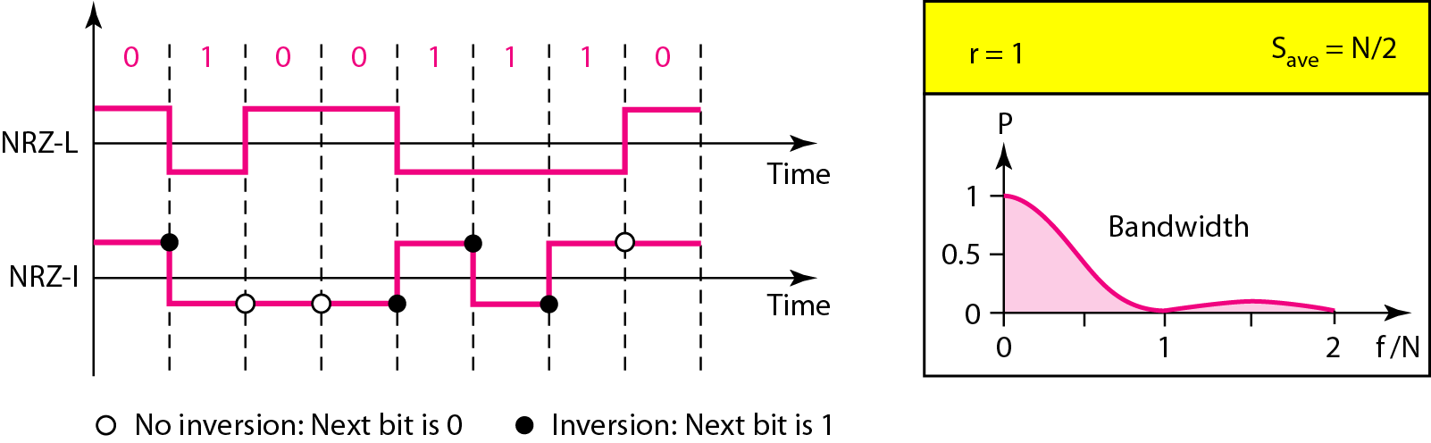
Polar NRZ-L and NRZ-I schemes
In NRZ-L the level of the voltage determines the value of the bit. In NRZ-I the inversion or the lack of inversion determines the value of the bit.

Slide 25
Line Coding: Polar
Return to Zero
Uses 3 values – Positive, Negative and Zero
Signal changes not between the bits but during the bit
Requires two signal changes to encode a bit and therefore occupies greater bandwidth
No DC component
More complex to create and discern as 3 levels
Hence not used these days
Replaced by Manchester and Differential Manchester schemes

Slide 26
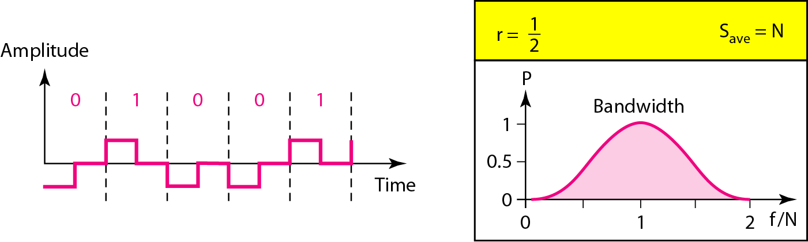
Polar RZ Scheme

Slide 27
Line Coding: Polar
Biphase
Manchester and Differential Manchester
Manchester Encoding has idea of NRZ-L and RZ
Differential Manchester Encoding combines idea of NRZ-I and RZ
No baseline wandering
No DC component
Signal rate is double than that for NRZ
There is always one transition at the middle of the bit and may be one transition at the end of each bit

Slide 28
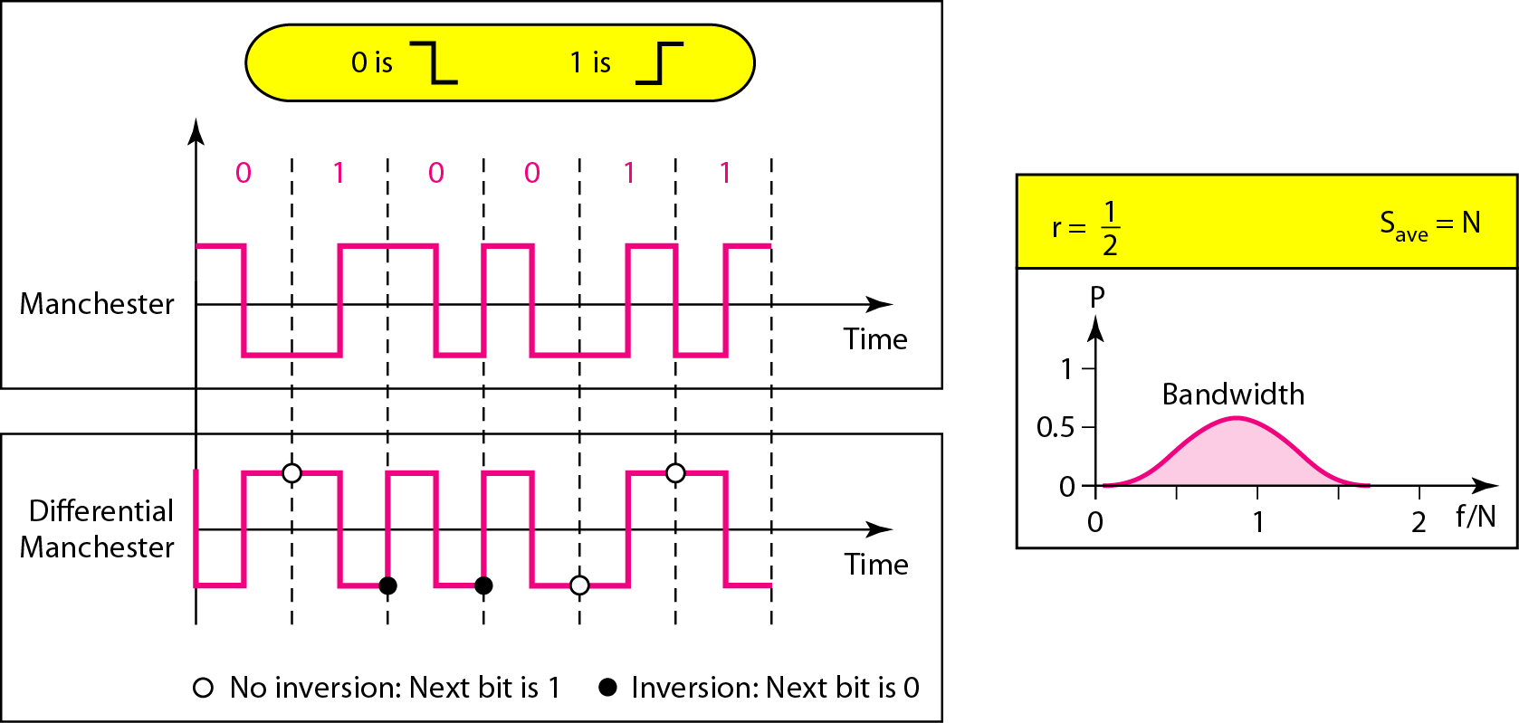
Polar Biphase: Manchester and Differential Manchester Schemes
In Manchester and differential Manchester encoding, the transition
at the middle of the bit is used for synchronization.

Slide 29
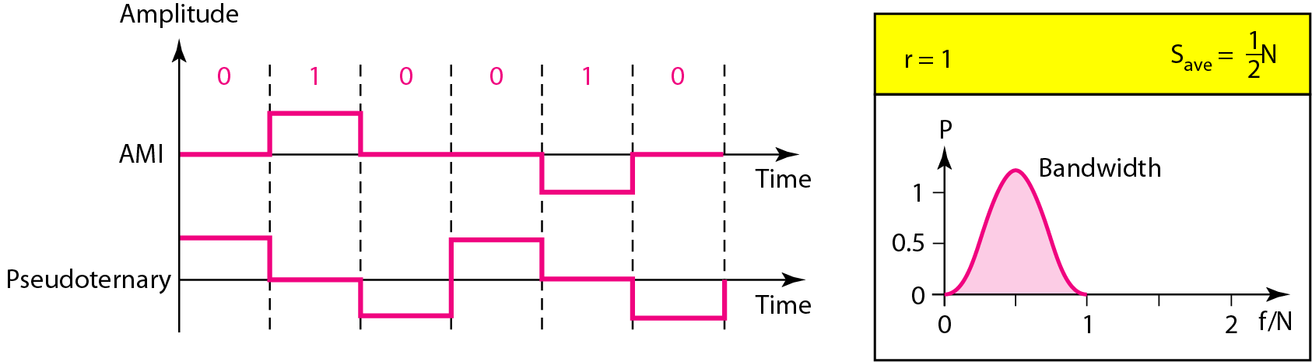
Line Coding: Bipolar
Also called multilevel binary
3 voltage levels – Positive, Negative, Zero
Voltage level for one data element is at zero, voltage level for other element alternates between positive and negative
AMI (Alternative Mark Inversion) and Pseudoternary

Slide 30
Line Coding: Bipolar
Same signal rate as NRZ
No DC component
Concentration of energy is found around frequency N/2
AMI is commonly used for long –distance communication
Has synchronization problem when a long sequence of 0s is present in the data

Slide 31
Line Coding: Multilevel Schemes
Goal is to increase the number of bits per baud by encoding a pattern of m data elements into a pattern of n signal elements
Group m data elements to produce a combination of 2^{m} data patterns
If there are L levels, L^{n} combinations of signal patterns can be produced
If 2^{m} = L^{n}, each data pattern is encoded in one signal pattern
If 2^{m} < L^{n}, data patterns occupy only a subset of signal patterns
This subset can be carefully designed to prevent baseline wandering, provide synchronization and to detect errors that occurred during transmission
Data encoding is not possible if If 2^{m} > L^{n}, because some data patterns cannot be encoded

Slide 32
Line Coding: Multilevel Schemes
Codes are classified as mBnL
m is length of binary pattern
B means binary data
n is length of signal pattern
L is number of levels in the signalling
2B1Q – two binary, one quaternary
8B6T – eight binary, six ternary
4D – PAM5 – four-dimensional five level pulse amplitude modulation

Slide 33
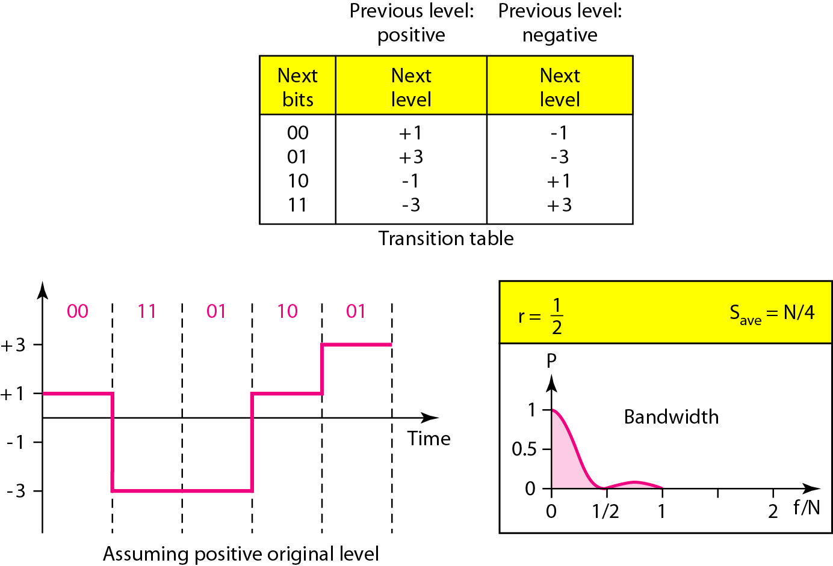
Multilevel: 2B1Q – used in Digital Subscriber Line (DSL)

Slide 34
In the 2B1Q scheme, we have no redundancy and we see that a DC component is present.
If we use a code with redundancy we can decide to use only “0” or “+” weighted codes (more +’s than -’s in the signal element) and invert any code that would create a DC component. E.g. ‘+00++-’ -> ‘-00--+’
Receiver will know when it receives a “-” weighted code that it should invert it as it doesn’t represent any valid symbol

Slide 35
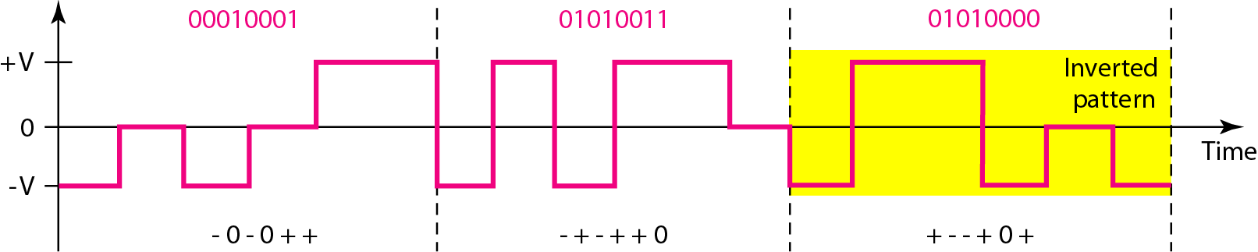
Multilevel: 8B6T – used with 100BASE-4T Cable
No. of data patterns = 2^8 = 256
L = 3
Signal elements = 6
Signal patterns possible = 3^6 = 729
Redundant signals = 729 – 256 = 473
Provide synchronization and error detection
Used to provide DC balance

Slide 36
Each signal has weight 0 or +1 DC values
No pattern with weight of -1
To create DC balance, sender inverts the actual signal
Receiver can easily recognize the inverted pattern as the weight is -1
Average Signal rate Save = ½ X N X 6/8
Minimum bandwidth is close to 6N/8

Slide 37
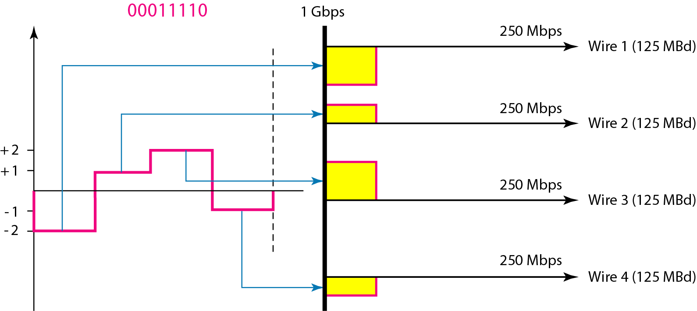
Multilevel: 4D-PAM5 Scheme – used in Gigabit LANs

Slide 38
In some cases, we split the signal transmission up and distribute it over several links.
The separate segments are transmitted simultaneously. This reduces the signaling rate per link -> lower bandwidth.
This requires all bits for a code to be stored.
xD: means that we use ‘x’ links
YYYz: We use ‘z’ levels of modulation where YYY represents the type of modulation (e.g. pulse amplitude modulation - PAM).
Codes are represented as: xD-YYYz

Slide 39
Line Coding: Multitransition: MLT-3
Uses 3 levels: +V, 0 and –V
Three transition rules
If the next bit is 0, there is no transition
If the next bit is 1 and the current level is not 0, the next level is 0
If the next bit is 1 and the current level is 0, the next level is the opposite of the last nonzero level

Slide 40
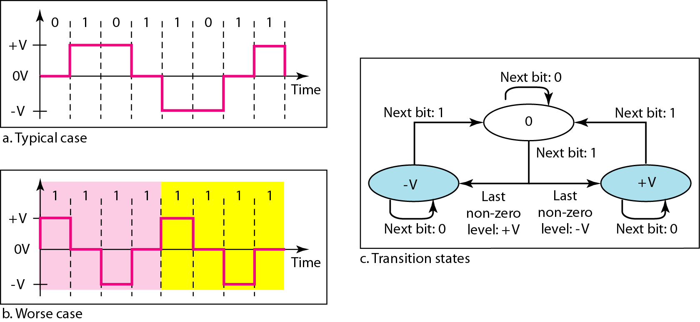
Multitransition: MLT-3 Scheme

Slide 41
Signal rate is same as NRZ-I
Because of the resulting bit pattern, we have a periodic signal for worst case bit pattern: 1111
This can be approximated as an analog signal a frequency 1/4 the bit rate!

Slide 42
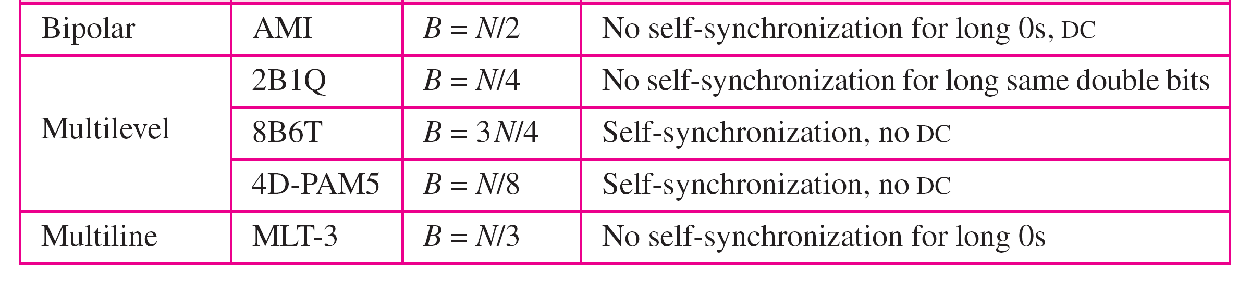

Slide 43
Block Coding
Block codes provide redundancy and improves performance of line coding
Redundancy is needed for synchronization and providing some kind of inherent error detecting
Block coding changes a block of m bits into a block of n bits
n > m
Referred to as mB/nB encoding technique involves 3 steps
Division – sequence of bits is divided into m-bits
Substitution – substitute an m-bit group with an n-bit group
Combination – n-bit group is combined to form a stream
The new stream has more bits than the original bits
Block coding is normally referred to as mB/nB coding;
It replaces each m-bit group with an n-bit group

Slide 44
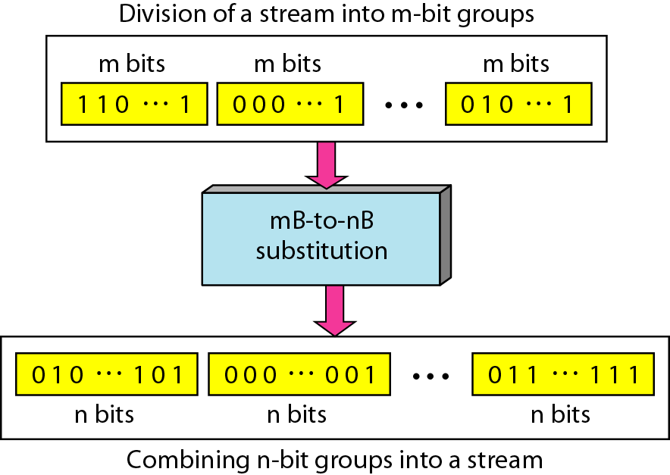
Block Coding Concept
The resulting bit stream prevents certain bit combinations that when used with line encoding would result in DC components or poor synchronization quality

Slide 45
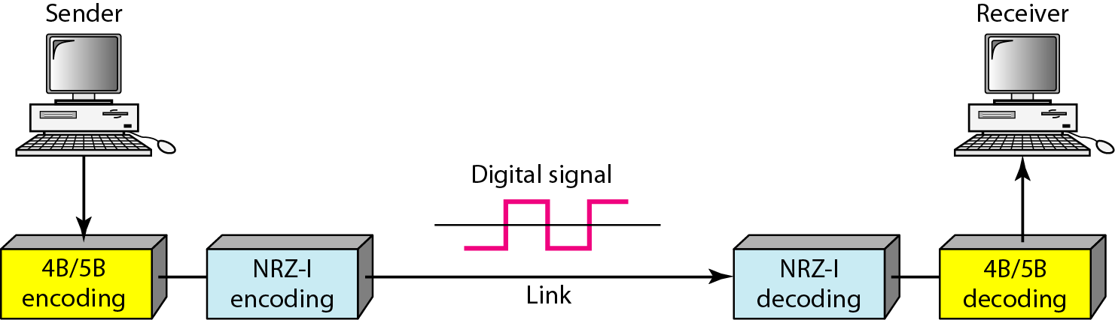
Using Block Coding 4B/5B with NRZ-I line coding scheme
Issues with NRZ-I (Revisited):
Synchronization problem – a long sequence of 0s can make receiver clock lose synchronization
Resolved with 4B/5B encoding:
Block coded stream does not have more than 3 consecutive zeros

Slide 46
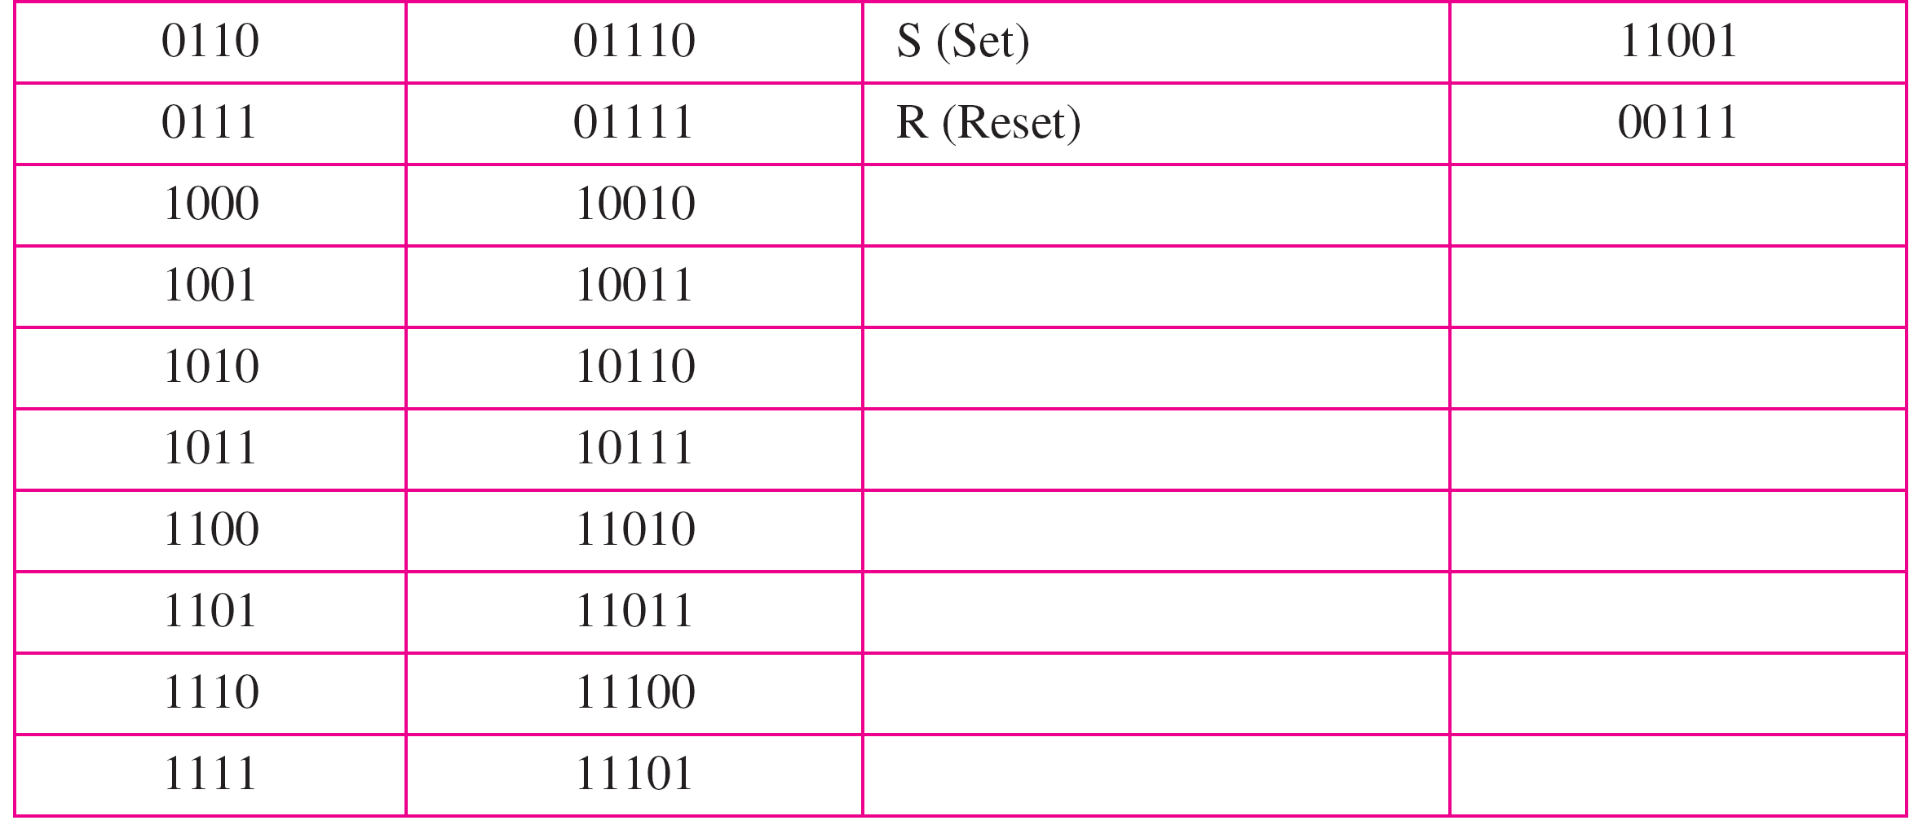
4B/5B Mapping codes

Slide 47
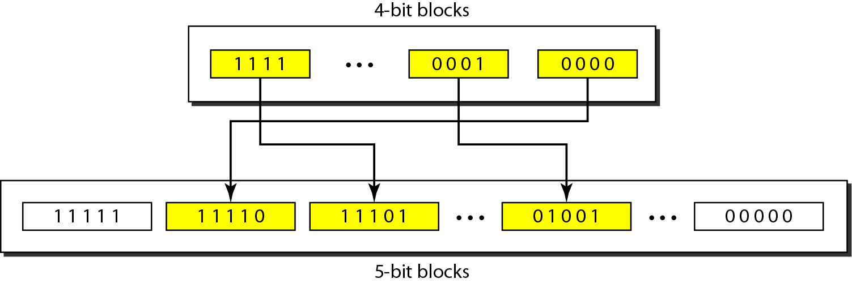
Substitution in 4B/5B block coding
Redundancy:
A 4 bit data word can have 2⁴ = 16 combinations
A 5 bit word can have 2⁵ = 32 combinations
No. of extra words = 32 – 16 = 16
Some of these extra words are used for control/signaling purposes

Slide 48
We need to send data at a 1-Mbps rate. What is the minimum required bandwidth, using a combination of 4B/5B and NRZ-I or Manchester coding?
Solution
First 4B/5B block coding increases the bit rate to 1.25 Mbps.
The minimum bandwidth using NRZ-I is N/2 or 625 kHz.
The Manchester scheme needs a minimum bandwidth of 1.25 MHz.
The first choice needs a lower bandwidth, but has a DC component problem;
The second choice needs a higher bandwidth, but does not have a DC component problem.

Slide 49
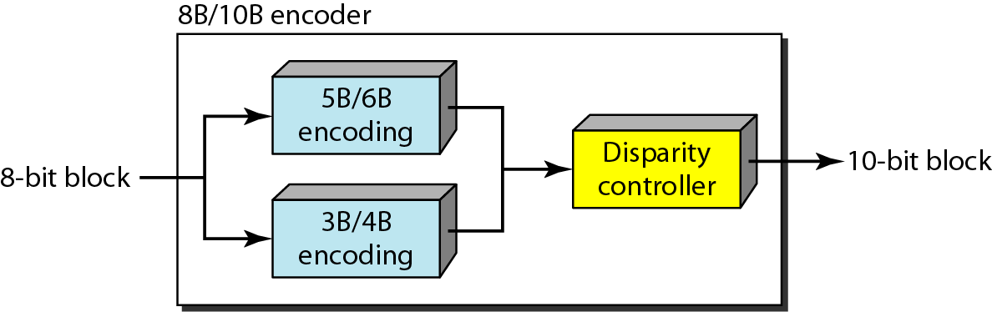
8B/10B Block Encoding
More the bits – better the error correction:
No. of redundant bits = 2¹⁰ – 2⁸ = 768
The 8B10B block code adds more redundant bits
Thereby choose code words that would prevent a long run of a voltage level that would cause DC components

Slide 50
Scrambling
Biphase schemes are not suitable in long distance communications due to wide bandwidth requirement
Combination of block codes and NRZ line coding are not suitable for long distance communications due to the of DC component
Bipolar AMI are preferred for long distances
Scrambling offers for a solution that does not increase number of bits and does provide synchronization
Modifies part of the AMI rule to include scrambling
System inserts required pulses based on the defined scrambling rules
Two common scrambling techniques
B8ZS
HDB3

Slide 51
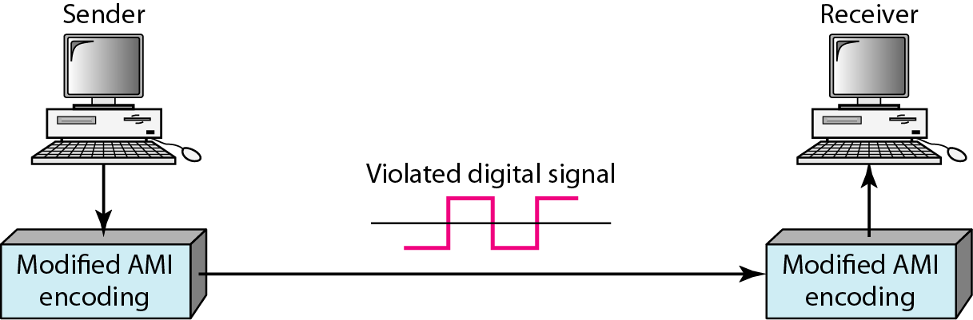
AMI used with Scrambling

Slide 52
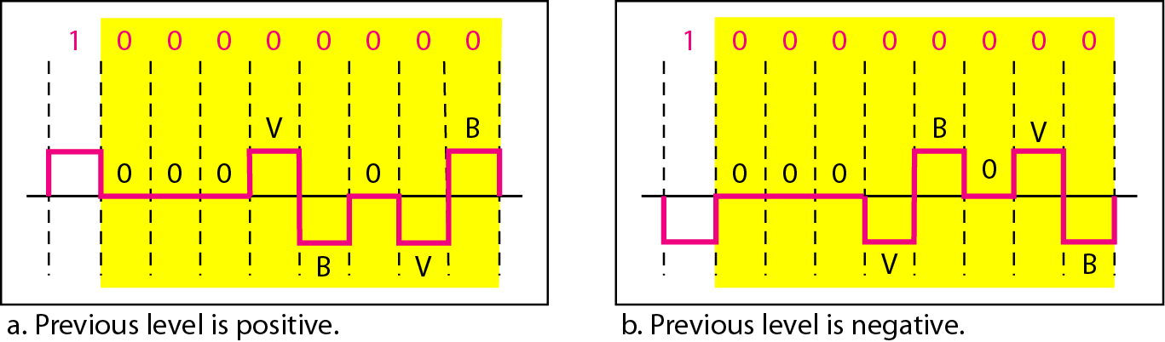
Two cases of B8ZS Scrambling
B8ZS substitutes eight consecutive zeros with 000VB0VB.
The V stands for violation, it violates the line encoding rule
B stands for bipolar, it implements the bipolar line encoding rule

Slide 53
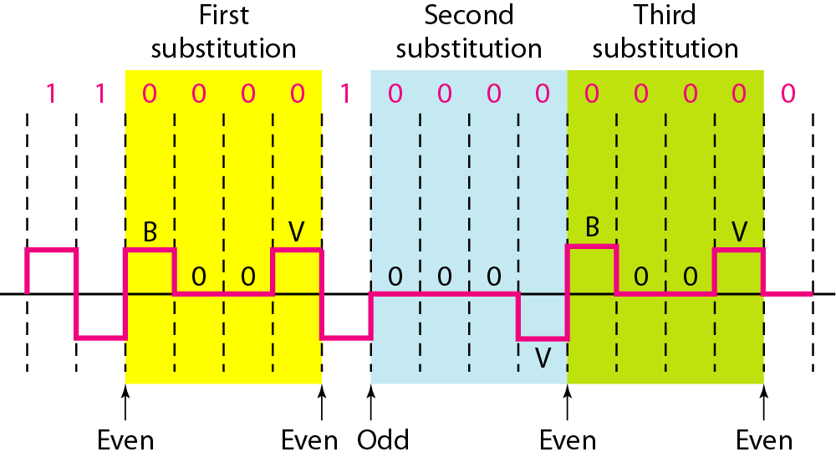
HDB3 substitutes four consecutive zeros with 000V or B00V depending
on the number of nonzero pulses after the last substitution.
If # of non zero pulses is even the substitution is B00V to make total # of non zero pulse even.
If # of non zero pulses is odd the substitution is 000V to make total # of non zero pulses even.

Slide 54
Analog-to-Digital Conversion
Pulse Code Modulation
Delta Modulation

Slide 55
Pulse Coded Modulation (PCM)
PCM is the most common technique to change an analog signal into digital (digitization)
PCM encoder has 3 processes
Sampling – analog signal is sampled
Quantization – analog signal is quantized
Encoding – quantized values are encoded as stream of bits

Slide 56
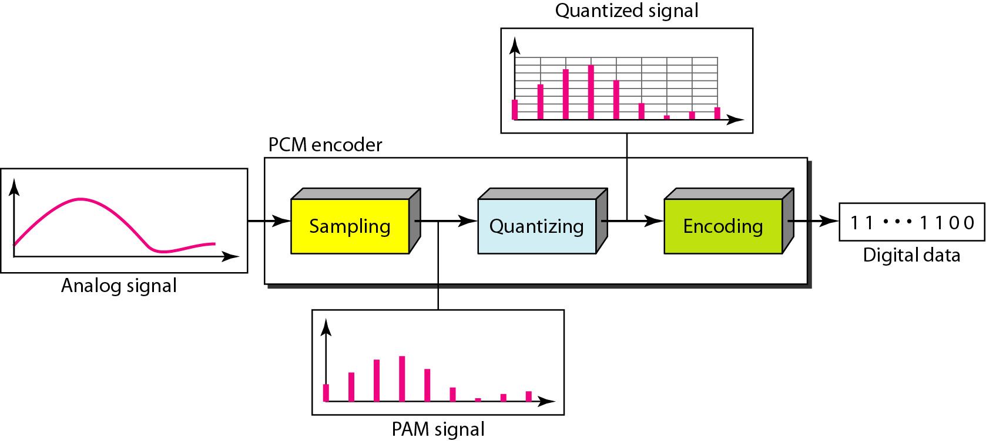
Components of the PCM Encoder

Slide 57
PCM (Sampling)
Analog signal is sampled every T_{S} secs
T_{s} is the sample interval or period
Inverse is called Sampling Rate or Sampling frequency (f_{s})
Three sampling methods:
Ideal - an impulse at each sampling instant
Cannot be easily implemented
Natural - a pulse of short width with varying amplitude
High-speed switch is turned on for a small period
Flat-top - sample and hold, like natural but with single amplitude value
Most common method created using a circuit
The process is referred to as pulse amplitude modulation PAM and the outcome is a signal with analog (non integer) values

Slide 58
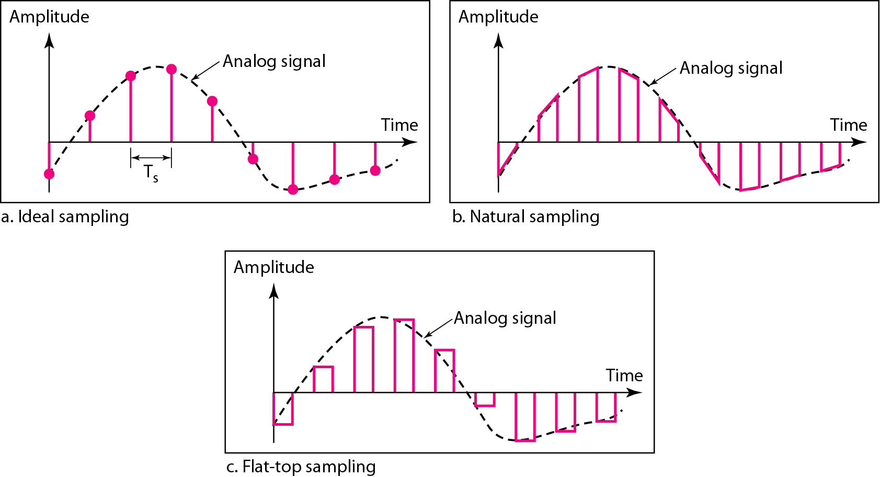
3 different Sampling Methods for PCM

Slide 59
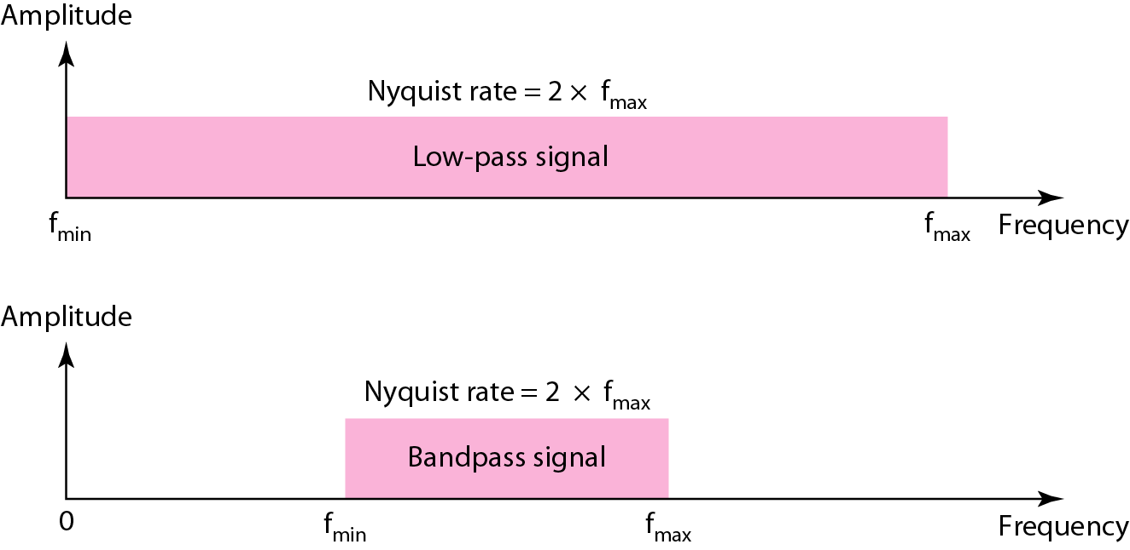
PCM: Sampling Rate
Nyquist Theorem
To reproduce the original analog signal, one necessary condition is that the sampling rate be at least twice the highest frequency in the original signal
Sampling can be done only if the signal is band-limited
Sampling rate must be 2 times the highest frequency; not the bandwidth
Nyquist sampling rate for low-pass and bandpass signals

Slide 60
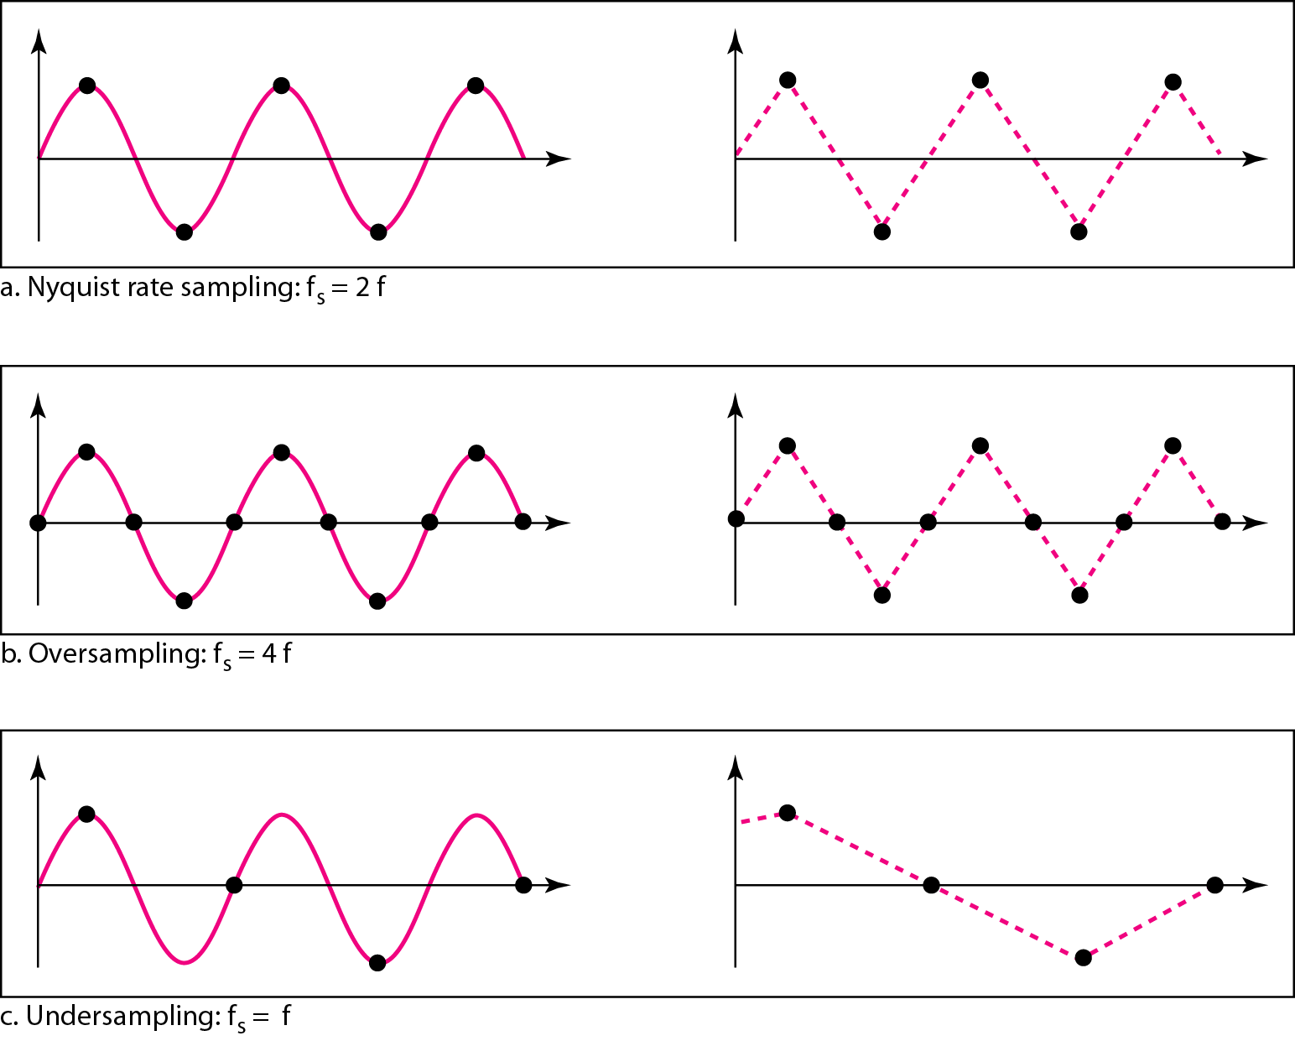
For an intuitive example of the Nyquist theorem, let us sample a simple sine wave at three sampling rates: f_{s} = 4f (2 times the Nyquist rate), f_{s} = 2f (Nyquist rate), and f_{s} = f (one-half the Nyquist rate).
Sampling at the Nyquist rate can create a good approximation of the original sine wave
Fig. b and Fig. c does not produce the original signal
Recovery of a sampled sine wave for different sampling rates

Slide 61
Consider the revolution of a hand of a clock.
The second hand of a clock has a period of 60 s.
According to the Nyquist theorem, we need to sample the hand every 30 s (T_{s} = T or f_{s} = 2f ).
In part a, the sample points, in order, are 12, 6, 12, 6, 12, and 6.
The receiver of the samples cannot tell if the clock is moving forward or backward
In part b, we sample at double the Nyquist rate (every 15 s). The sample points are 12, 3, 6, 9, and 12.
The clock is moving forward
In part c, we sample below the Nyquist rate (T_{s} = T or f_{s} = f ).
The sample points are 12, 9, 6, 3, and 12.
Although the clock is moving forward, the receiver thinks that the clock is moving backward.

Slide 62
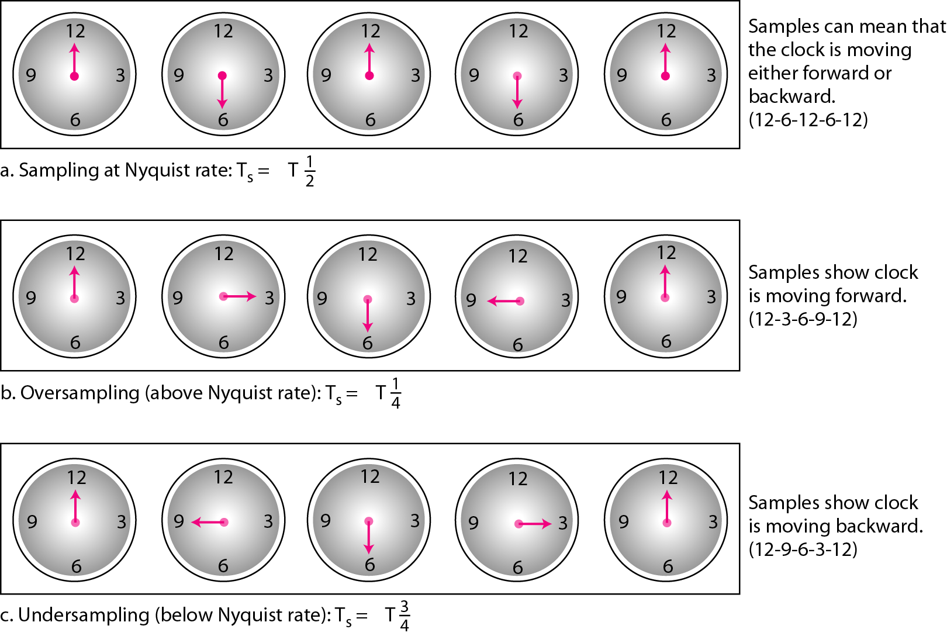
Sampling of the clock with only one hand

Slide 63
An example related to seemingly backward rotation of the wheels of a forward-moving car in a movie. This can be explained by under-sampling. A movie is filmed at 24 frames per second. If a wheel is rotating more than 12 times per second, the under-sampling creates the impression of a backward rotation
Telephone companies digitize voice by assuming a maximum frequency of 4000 Hz. The sampling rate therefore is 8000 samples per second
A complex low-pass signal has a bandwidth of 200 kHz. What is the minimum sampling rate for this signal?
Solution
The bandwidth of a low-pass signal is between 0 and f, where f is the maximum frequency in the signal. Therefore, we can sample this signal at 2 times the highest frequency (200 kHz). The sampling rate is therefore 400,000 samples per second
A complex bandpass signal has a bandwidth of 200 kHz. What is the minimum sampling rate for this signal?
Solution
We cannot find the minimum sampling rate in this case because we do not know where the bandwidth starts or ends. We do not know the maximum frequency in the signal.

Slide 64
PCM: Quantization
Sampling results in a series of pulses of varying amplitude values ranging between two limits: a_{min} and a_{max}
The amplitude values are infinite between the two limits
Need to map the infinite amplitude values onto a finite set of known values
This is achieved by dividing the distance between min and max into L zones, each of height Δ.
= (max - min)/L
The midpoint of each zone is assigned a value from 0 to L-1 (resulting in L values)
Each sample falling in a zone is then approximated to the value of the midpoint

Slide 65
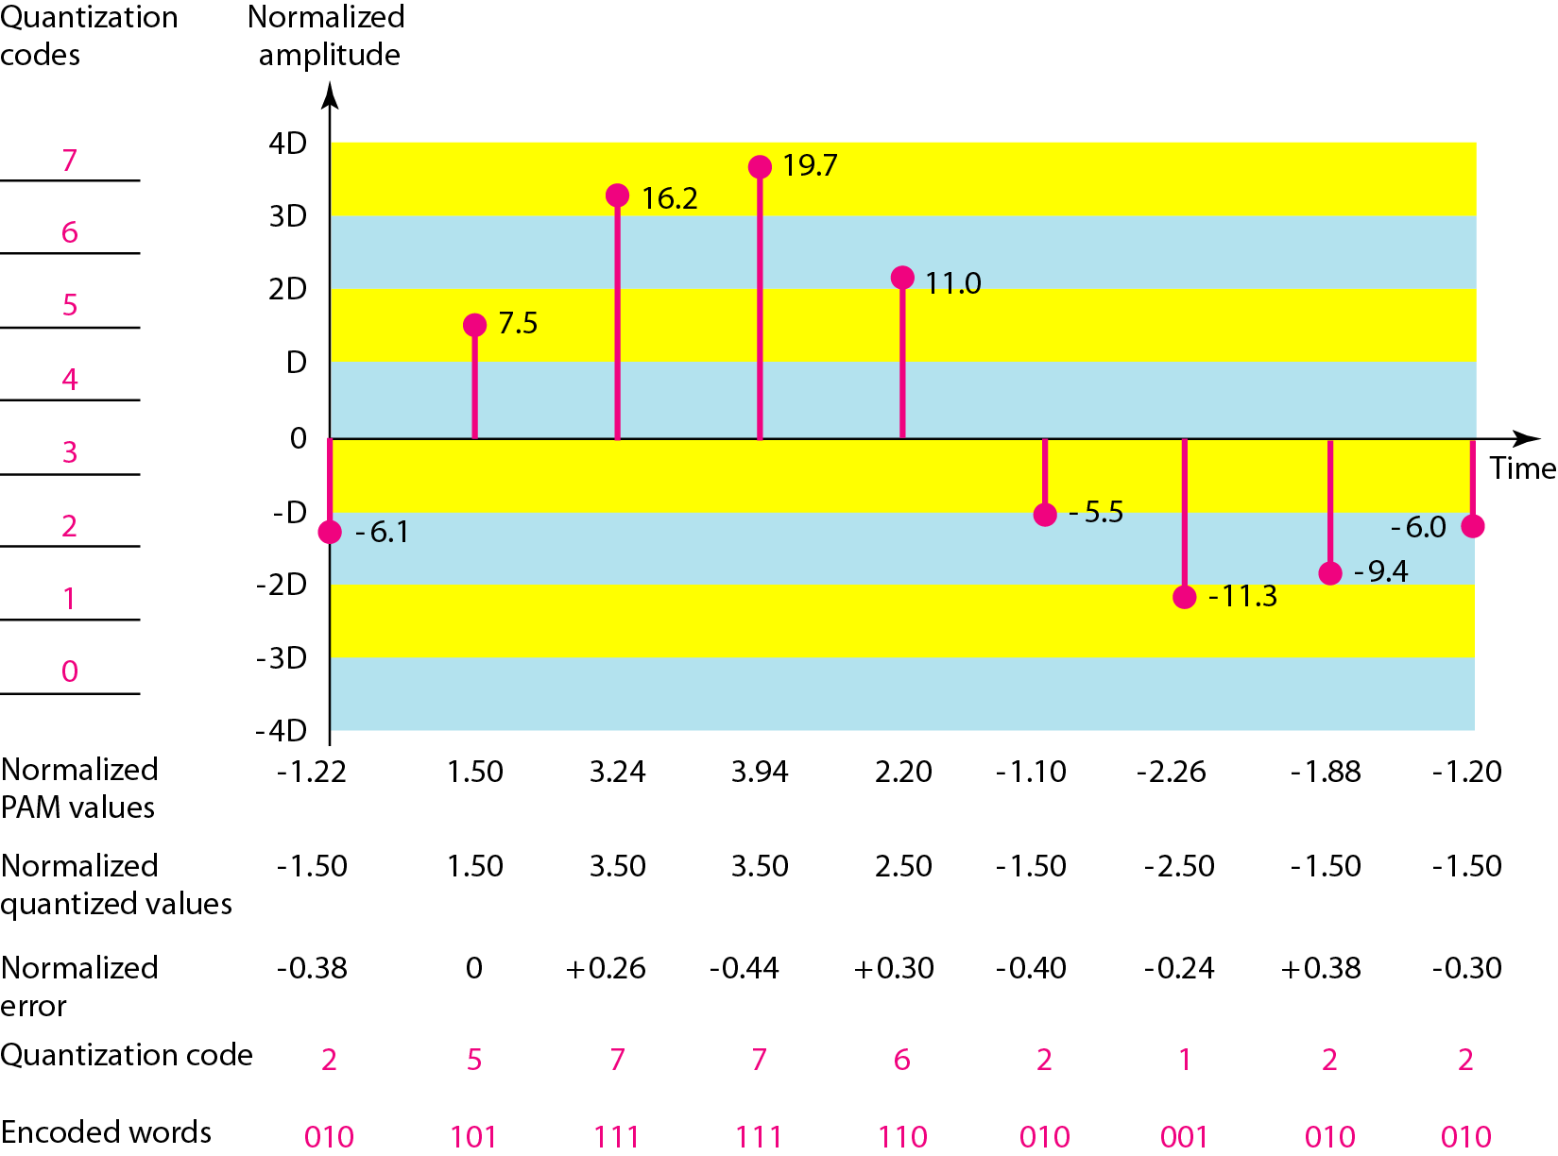
Quantization and Encoding of a sampled signal

Slide 66
Maximum Voltage Vmax = 20 V
Minimum Voltage Vmin = - 20 V
Figure shows the actual amplitudes (ideal sampling)
Normalized PAM values = actual amplitudes / ∆
Normalized Quantized values = (mid point amplitude in each zone) / ∆
Normalized error = Normalized Quantized values – Normalized PAM values
Quantization code – is based on the quantization levels at the left of the graph
Encoded works – final products of the conversion

Slide 67
Quantization Zones
Assume a voltage signal with amplitudes
V_{min}= - 20V and V_{max} = + 20V.
We want to use L = 8 quantization levels
Zone width Δ = (20 – (-20))/8 = 5
The 8 zones are: -20 to -15, -15 to -10, -10 to -5, -5 to 0, 0 to +5, +5 to +10, +10 to +15, +15 to +20
The midpoints are: -17.5, -12.5, -7.5, -2.5, 2.5, 7.5, 12.5, 17.5
Assigning Codes to Zones
Each zone is then assigned a binary code.
The number of bits required to encode the zones, or the number of bits per sample is as follows:
n_{b} = log ₂ L
Given our example, n_{b} = 3
The 8 zone (or level) codes are therefore: 000, 001, 010, 011, 100, 101, 110, and 111
Assigning codes to zones:
000 will refer to zone -20 to -15
001 to zone -15 to -10, etc.

Slide 68
Quantization Error
When a signal is quantized, we introduce an error - the coded signal is an approximation of the actual amplitude value.
The difference between actual and coded value (midpoint) is referred to as the quantization error.
The more zones, the smaller Δ which results in smaller errors.
BUT, the more zones the more bits required to encode the samples -> higher bit rate
Changes the signal-to-noise ratio of the signal
Reduces upper limit capacity (as per Shannon)
Signals with lower amplitude values will suffer more from quantization error as the error range: Δ/2, is fixed for all signal levels
Non linear quantization is used to alleviate this problem. Goal is to keep SNR fixed for all sample values
SNR_{db} = 6.02 n_{b} + 1.76 dB
N_{b} = log ₂ L

Slide 69
What is SNR_{db} in the previous example?
SNR_{dB} = 6.02(3) + 1.76 = 19.82 dB
A telephone subscriber line must have an SNR_{db} above 40. What is the minimum number of bits per sample?
SNR_{db} = 6.02 n_{b} + 1.76 = 40 ➔ n = 6.35

Slide 70
Uniform Versus Nonuniform Quantization
For many applications, the distribution of instantaneous amplitudes in the analog signal is not uniform
Amplitude changes more frequently in lower amplitudes than in higher ones
Hence, use non-uniform zones
Height of ∆ is not fixed
∆ is greater at lower amplitudes and less at higher amplitudes
Achieved by using a process called companding (at sender) and expanding (at receiver)
Companding reduces the instantaneous voltage amplitude for large values
Gives greater weightage to strong signals
Gives less weightage to weak signals
Expanding is the opposite of companding
Effectively reduces SNR_{db} of quantization

Slide 71
Encoding
After each sample is quantized, number of bits per sample is decided
Each sample is changed to an n_{b} – bit code word
Number of bits for each sample (n_{b}) is determined by the number of quantization levels (L)
n_{b} = log ₂ L
Bit rate = sampling rate X number of bits per sample
Bit rate = f_{s} x n_{b}
We want to digitize the human voice. What is the bit rate, assuming 8 bits per sample?
Solution
The human voice normally contains frequencies from 0 to 4000 Hz. So the sampling rate and bit rate are calculated as follows:

Slide 72
Original Signal recovery
Requires PCM decoder
Decoder uses circuitry to convert the code words into a pulse that holds the amplitude until the next pulse
Stair-case pulse so created is sent through low pass filter to generate smooth analog signal
Filter has same cut-off frequency as the original signal at the sender
If the signal is sampled at the Nyquist sampling rate (or greater), if enough quantization levels are available, original signal will be recreated
Maximum and minimum values of original signal can be achieved by amplification

Slide 73
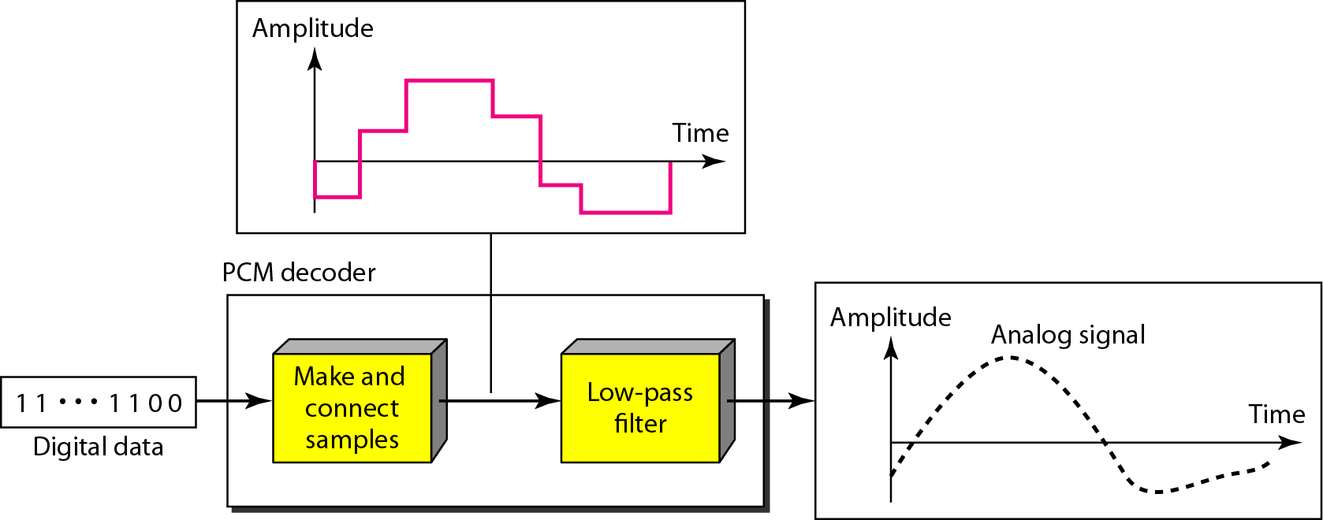
Components of the PCM decoder

Slide 74
PCM Bandwidth
Minimum bandwidth of a line-encoded signal
B_{min} = c X N X (1/r)
B_{min} = c X n_{b} X f_{s} X (1/r)
B_{min} = c X n_{b} X 2 X B_{analog} X (1/r)
When 1/r = 1 for NRZ or bipolar and c = ½ (the average situation)
B_{min} = n_{b} X B_{analog}
Minimum bandwidth of digital signal is n_{b} times greater than the bandwidth of the analog signal
Price we pay for digitization

Slide 75
We have a low-pass analog signal of 4 kHz. If we send the analog signal, we need a channel with a minimum bandwidth of 4 kHz. If we digitize the signal and send 8 bits per sample, we need a channel with a minimum bandwidth of 8 × 4 kHz = 32 kHz.

Slide 76
Maximum Data Rate of a Channel
Data rate of the channel
N_{max} = 2 X B X log ₂ L
Proof:
Assume that the available channel is low-pass with bandwidth B
Assume that the digital signal we want to send has L levels, each level is a signal element
r = 1/log ₂ L
First pass the digital signal through a low – pass filter to cut off the frequencies above B Hz
Treat the resulting signal as an analog signal and sample it at 2 X B samples per second and quantize it using L levels
Additional levels are useless as the original signal had L levels
Resulting bit rate is
N = f_{s} X n_{b} = 2 X B X log ₂ L
Hence, the maximum bandwidth is
N_{max} = 2 X B X log₂L bps
Minimum Required Bandwidth
B_{min} = N /(2 X log₂L) Hz

Slide 77
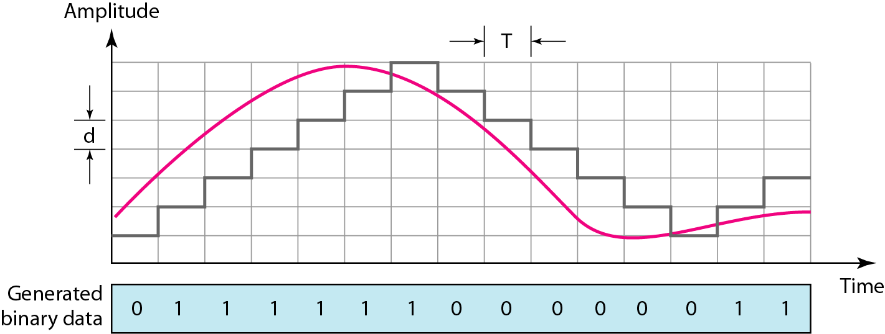
Delta Modulation
PCM is a very complex technique
PCM finds value of signal amplitude for each sample | DM finds chane from previous sample
Process of delta modulation

Slide 78
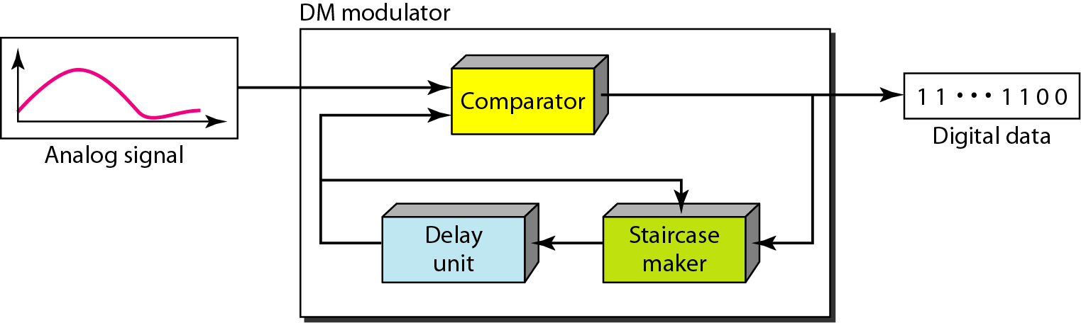
Components of Delta Modulation
Modulator used at sender site
Create stream of bits from the analog signal
Process records small positive or negative changes called delta ()
Records 1 or 0 respectively
Process needs a base
Builds a second signal that resembles a stair case
Hence, finding the change is reduced to comparing the input signal with gradually made staircase signal
Delay unit holds the staircase function for a period between two comparisons

Slide 79
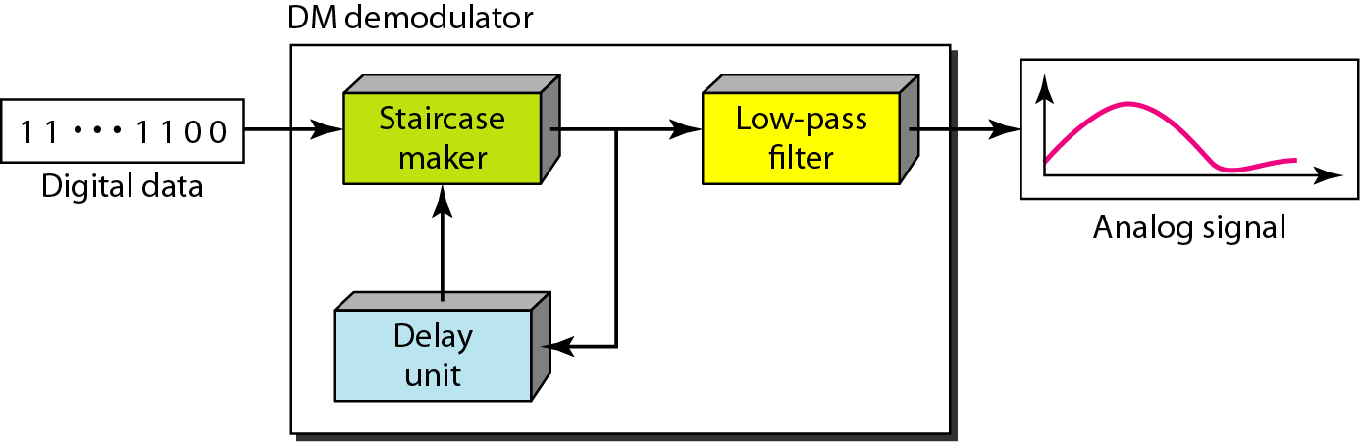
Components of Delta demodulation
Demodulator used at receiver site
Takes digital data and, using staircase maker and delay unit, creates analog signal
The analog signal needs to pass through a low pass filter for smoothing
Adaptive DM
If  value is not fixed, better performance can be achieved
Value of  changes according to amplitude of analog signal
Quantization error is introduced
But, much less than that for PCM

Slide 80
Transmission modes
Parallel Transmission
Serial Transmission

Slide 81
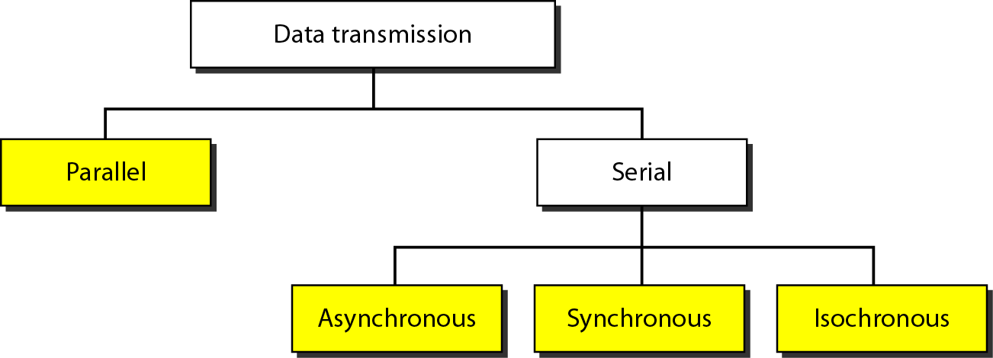
Data Transmission Modes

Slide 82
Parallel Transmission
Parallel Transmission – multiple bits are sent with each clock tick
Binary data is organized into groups of n bits each
By grouping, we send data n bits at a time instead of 1
Use n wires to send n bits at one time
Advantage:
Speed
Can increase transfer speed by a factor of n over serial transmission
Disadvantage
Cost
Hence, limited to short distances

Slide 83
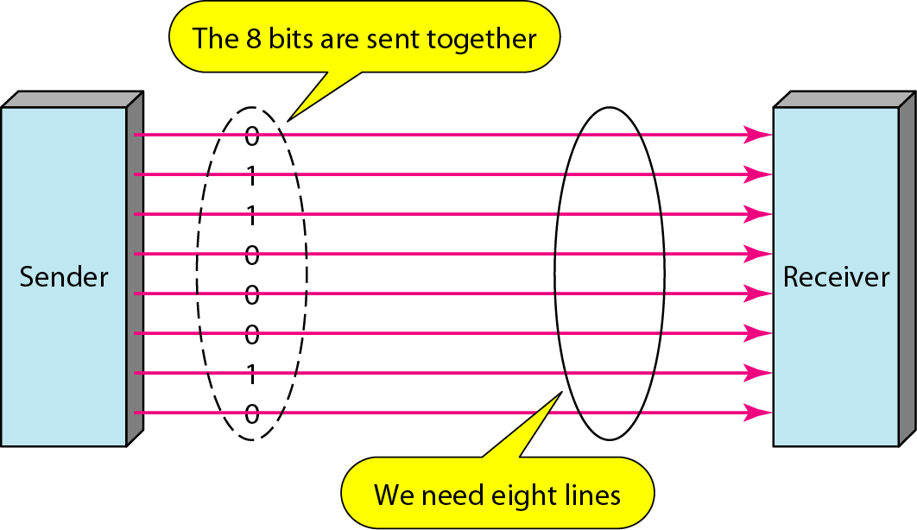
Parallel Transmission

Slide 84
Serial Transmission
One bit follows another
Hence, only one communication channel is needed rather than n to transmit data between two communicating devices
Advantage:
Reduces cost of transmission over parallel by roughly a factor of n
Since communication within devices is parallel
Conversion devices are required at interface between sender and the line (parallel – to – serial) and between the line and the receiver (serial – to – parallel)
Serial transmission occurs in
Asynchronous
Synchronous
Isosynchronous

Slide 85
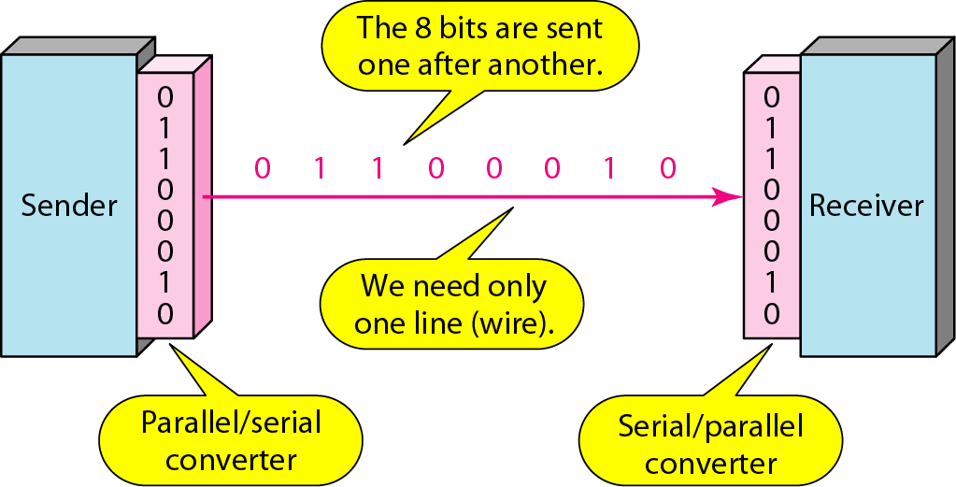
Serial Transmission

Slide 86
Serial transmission: Asynchronous Transmission
Timing of the signal is unimportant
Information is received and translated by agreed upon patterns
Patterns are based on grouping bit stream into bytes
Each group (8 bits) is sent along the link as a unit
Sending system handles each group independently
Relaying to link without regard to a timer
Without synchronization, receiver cannot use timing to predict when the next group will arrive
To alert receiver, an extra bit (0) is added to beginning of each byte
Also called start bit
To let receiver know that the byte is finished, 1 or more additional bits are appended to the end of the byte
Also called stop bits

Slide 87
To transmit 1 byte, at least 10 bits are transmitted
2 additional bits for control
Transmission of each byte may be followed by a gap of varying duration
This gap can be represented either by an idle channel or by a stream of additional stop bits
In asynchronous transmission, we send 1 start bit (0) at the beginning and 1 or more stop bits (1s) at the end of each byte. There may be a gap between each byte.
Asynchronous here means “asynchronous at the byte level,”
but the bits are still synchronized; their durations are the same.

Slide 88
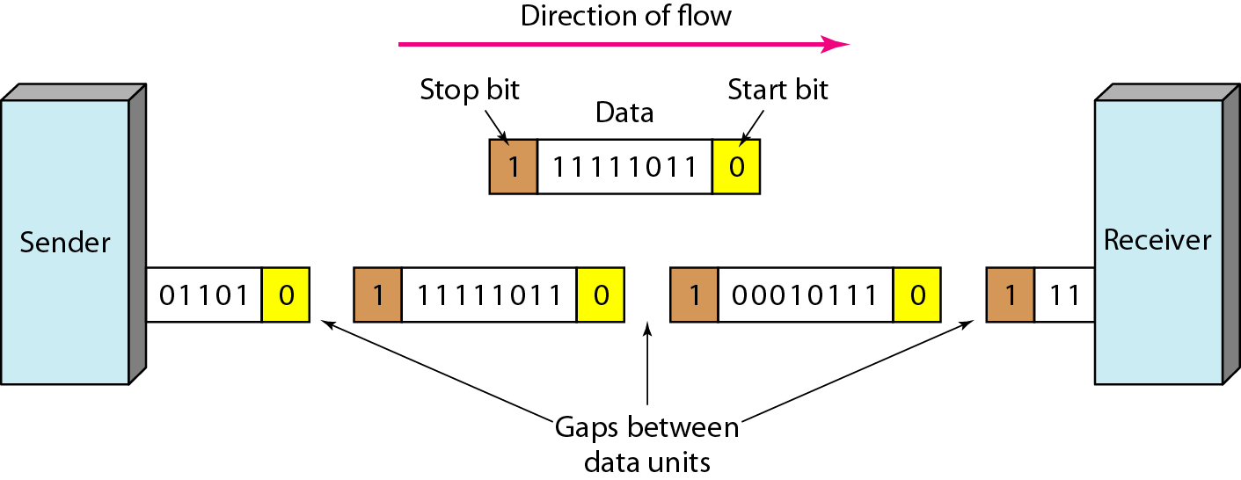
Asynchronous Transmission
Example:
Connection of a keyboard to a computer
User types only one character at a time
Extremely slowly in terms of data processing
Leaves unpredictable gaps of time between characters

Slide 89
Serial Transmission: Synchronous Transmission
Bit stream is combined into longer frames, which may contain multiple bytes
Each byte is introduced onto the transmission link without a gap between it and the next one
Left to the Receiver to separate bit stream into bytes for decoding purposes
Data are transmitted as an unbroken string of 1s and 0s and receiver separates that string into bytes or characters
In synchronous transmission, we need bits one after another without start or stop bits or gaps. It is the responsibility of the receiver to group the bits.

Slide 90
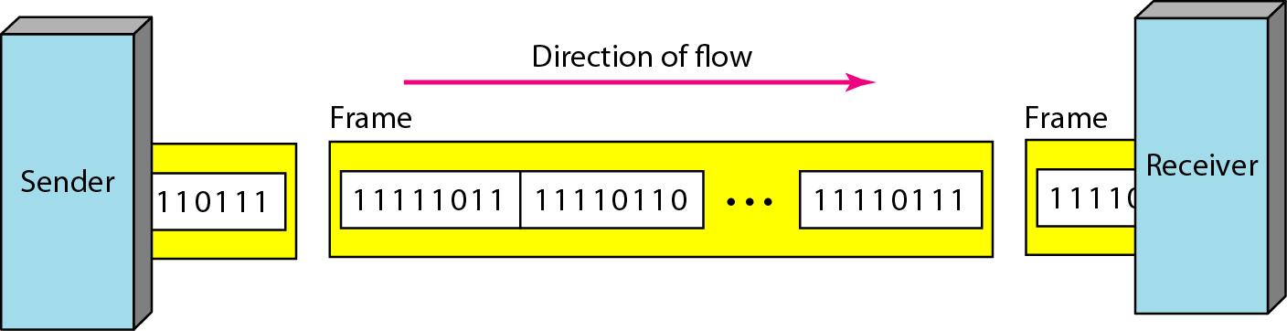
Synchronous transmission
The divisions shown do not exist
Sender puts data onto the line as long string
If sender puts data in bursts, the gaps must be filled with special sequence of 0s and 1s i.e. to represent an idle channel
Faster than the asynchronous as no extra bits or gaps
More useful for high-speed applications
Byte synchronization is accomplished in the data-link layer
Uneven gaps may be found between frames
Without gaps, start and stop bits, there is no built-in mechanism to help receiving device adjust its bit synchronization midstream.

Slide 91
Serial Transmission: Isochronous
In real-time audio and video, uneven delays between frames are not acceptable
Synchronous transmission hence fails
Guarantees that the data arrive at a fixed rate
Example:
TV images are broadcast at the rate of 30 images per second
They must be viewed at the same rate
If each image is sent by using one or more frames, there should be no delays between frames
Hence synchronization of characters is not enough; the entire stream of bits must be synchronized

Slide 92
Thank You!!!

